Slide 1
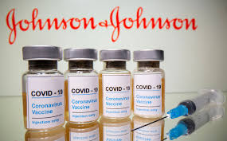
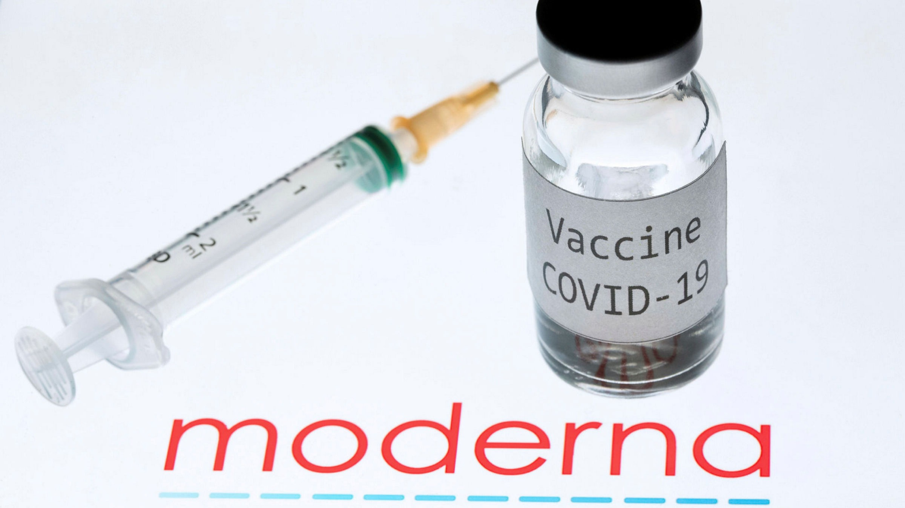
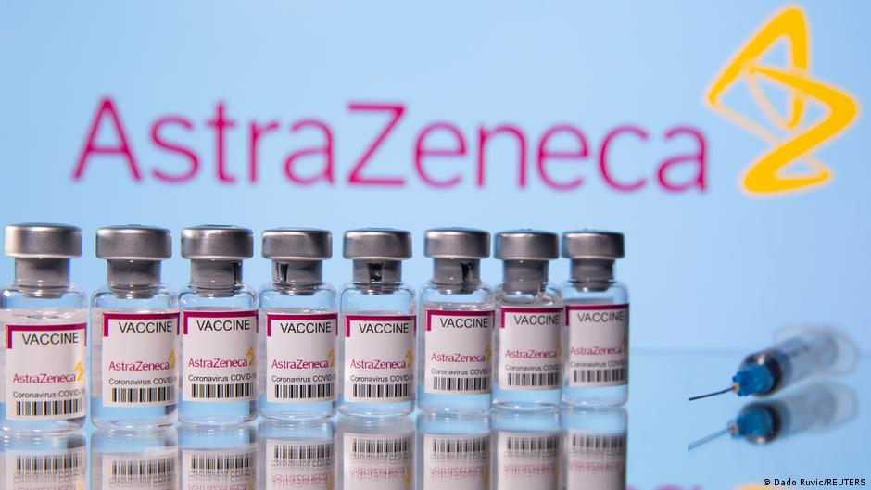
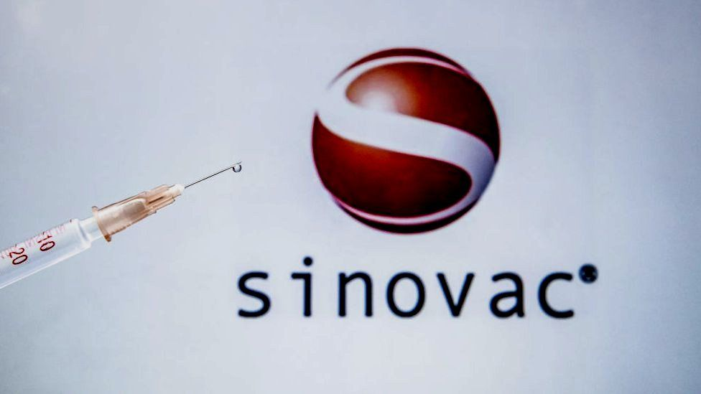
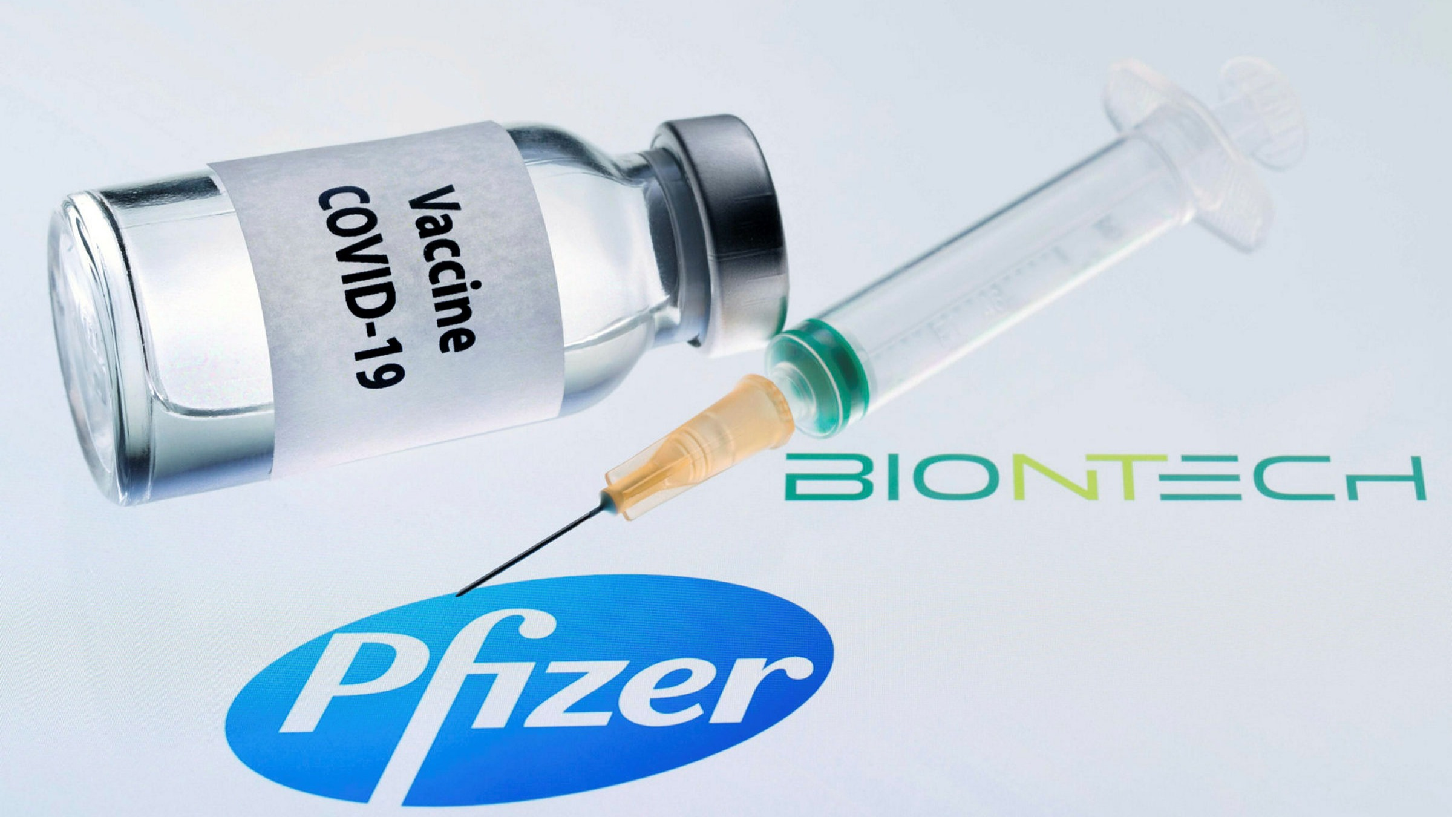
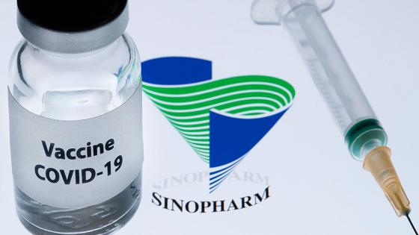
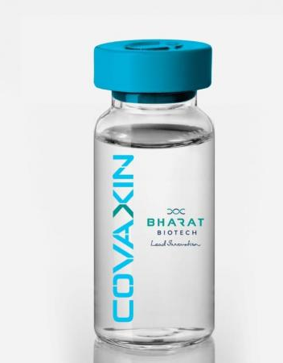
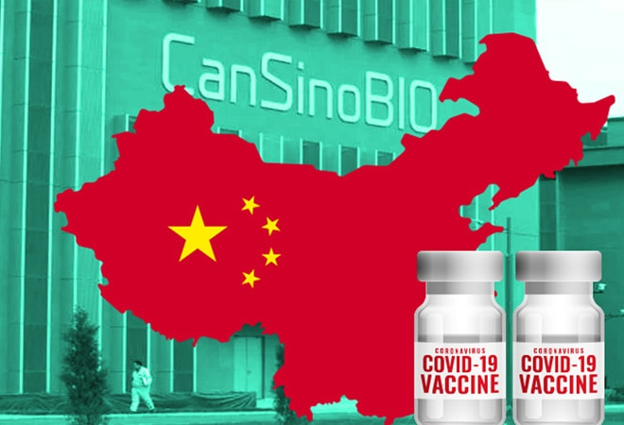
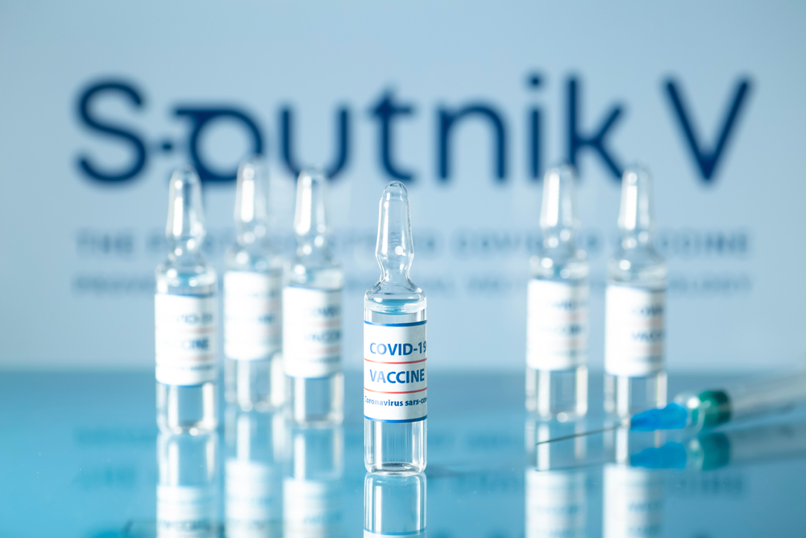
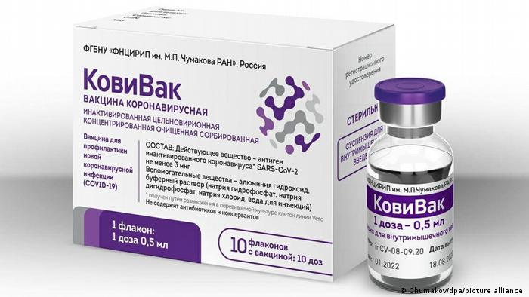
Covid-19 Vaccines
Approvals as of March 15, 2021
and associated stock trends

Slide 2
Datasets
Stock market – Yahoo Finance – daily close values
Vaccine approval dates - https://www.raps.org/news-and-articles/news-articles/2020/3/covid-19-vaccine-tracker

Slide 3
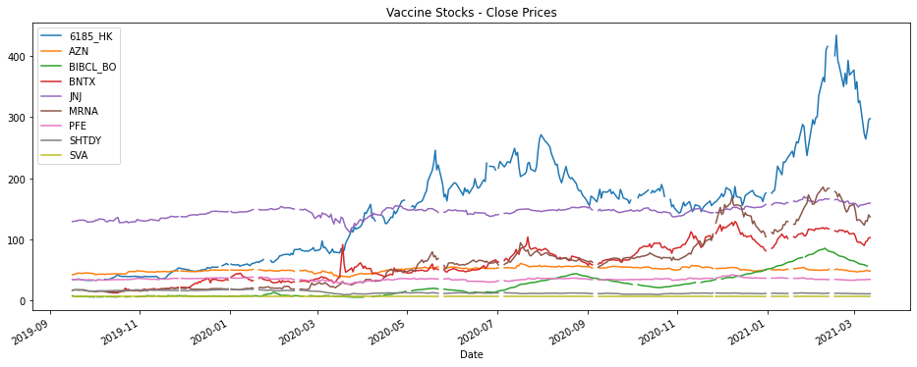
Yahoo Finance datasets

Slide 4
Vaccine approval dates
( https://www.raps.org/news-and-articles/news-articles/2020/3/covid-19-vaccine-tracker )
# Pfizer/BNTX approval dates
PFE_approvals = {'Australia':'2021-01-25', 'Brazil':'2021-02-23', 'Canada':'2020-12-09', 'EU':'2020-12-21',
'Japan':'2021-02-14', 'Mexico':'2020-12-11', 'Saudi Arabia':'2020-12-10', 'South Korea':'2021-03-05',
'Switzerland':'2021-01-12', 'UK':'2020-12-02', 'US':'2020-12-11', 'WHO':'2020-12-31'}
# BNTX_approvals = PFE_approvals # BNTX collaborated with PFE to produce a vaccine
# Moderna
MRNA_approvals = {'Canada':'2020-12-09', 'EU':'2021-01-06', 'Switzerland':'2021-01-08', 'UK':'2021-01-08', 'US':'2020-12-18'}
# AstraZenica
AZN_approvals = {'Australia':'2020-12-30', 'Brazil':'2021-01-17', 'Canada':'2021-02-26', 'EU':'2021-01-29', 'India':'2021-01-03',
'Indonesia':'2021-03-09', 'Japan':'2021-02-05', 'Mexico':'2021-01-04', 'Nigeria':'2021-02-18', 'South Korea':'2021-02-10',
'Thailand':'2021-01-21', 'UK':'2020-12-29', 'WHO':'2021-02-15'}
# Johnson & Johnson
JNJ_approvals = {'Canada':'2021-03-05', 'EU':'2021-03-11', 'US':'2021-02-27', 'WHO':'2021-03-12'}
# Sinovac
SVA_approvals = {'Brazil':'2021-01-17', 'China':'2021-02-06', 'Indonesia':'2021-01-12', 'Mexico':'2021-02-10',
'Thailand':'2021-02-22', 'Turkey':'2021-01-14'}
# Sinopharm
SHTDY_approvals = {'China':'2020-12-30'}
# Sinopharm 2nd vaccine candidate
SHTDY_2_approvals = {'China':'2021-02-27'}
#CanSino Biologics (ticker: "6185.HK")
CanSino_approvals = {'China':'2021-02-25', 'Mexico':'2021-02-10'}
# Bharet (ticker: BIBCL.BO)
BIBCL_approvals = {'India':'2021-01-03'}
# Russian state-funded vaccines (No associated tickers)
SputnikV_approvals = {'Mexico':'2021-02-04', 'Russia':'2020-08-11'}
CoviVac_approvals = {'Russia':'2021-02-20'}
Focusing on largest economies (according to https://www.investopedia.com/insights/worlds-top-economies/ ) plus WHO
# EU countries were grouped into a single EU label
# 19 JURISDICTIONS TOTAL:
# Australia, Brazil, Canada, China, EU, India, Indonesia, Japan, Mexico, Nigeria,
# Russia, Saudi Arabia, South Korea, Switzerland, Thailand, Turkey, UK, US, WHO
VACCINES : APPROVALS {'PFE / BNTX': 12, 'MRNA': 5, 'AZN': 13, 'JNJ': 4, 'SVA': 6, 'SHTDY_1': 1, 'SHTDY_2': 1, 'CanSino': 2, 'BIBCL.BO': 1, 'Sputnik V': 2, 'CoviVac': 1}

Slide 5
Who is approving whose vaccines?
Which economies developed the most widely approved vaccines?
Any national biases? (Protectionism?)

Slide 6
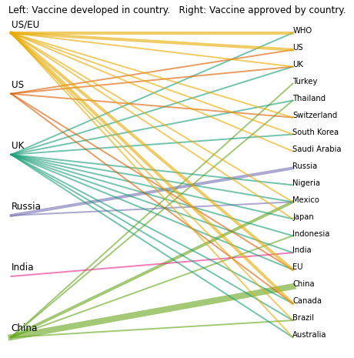
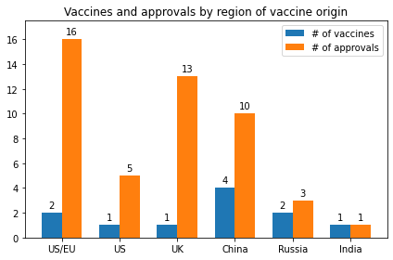
VACCINES : APPROVALS {'PFE / BNTX': 12, 'MRNA': 5, 'AZN': 13, 'JNJ': 4, 'SVA': 6, 'SHTDY_1': 1, 'SHTDY_2': 1, 'CanSino': 2, 'BIBCL.BO': 1, 'Sputnik V': 2, 'CoviVac': 1}
PFE/BNTX
JNJ
MRNA
AZN
Sputnik V
CoviVac
PFE/BNTX
JNJ
MRNA
AZN
SVA
SHTDY
CanSino (6185.HK)
Sputnik V
CoviVac
Bharet (BIBCL.BO)
Bharet (BIBCL.BO)
Origin economies by number of approvals:
US/EU > UK > China > US > Russia > India
Evidence of protectionism?
US, China, Russia only approved their own vaccines.
Only 5/19 jurisdictions approved vaccines from both America/Europe and Asia:
Thailand, Mexico, Indonesia, India, Brazil
SVA
SHTDY
CanSino (6185.HK)

Slide 7
VACCINES : APPROVALS {'PFE / BNTX': 12, 'MRNA': 5, 'AZN': 13, 'JNJ': 4, 'SVA': 6, 'SHTDY_1': 1, 'SHTDY_2': 1, 'CanSino': 2, 'BIBCL.BO': 1, 'Sputnik V': 2, 'CoviVac': 1}
PFE/BNTX
JNJ
MRNA
AZN
Sputnik V
CoviVac
PFE/BNTX
JNJ
MRNA
AZN
SVA
SHTDY
CanSino (6185.HK)
Sputnik V
CoviVac
Bharet (BIBCL.BO)
Bharet (BIBCL.BO)
Origin economies by number of approvals:
US/EU > UK > China > US > Russia > India
Evidence of protectionism?
US, China, Russia only approved their own vaccines.
Only 5 out of 19 jurisdictions approved vaccines from both America/Europe and Asia:
Thailand, Mexico, Indonesia, India, Brazil
SVA
SHTDY
CanSino (6185.HK)

Slide 8
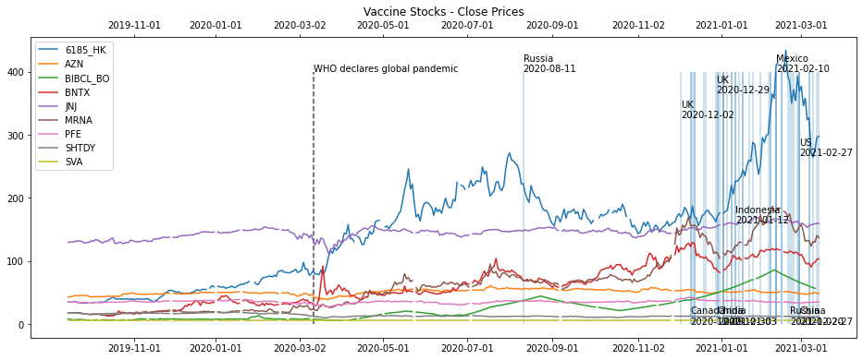
How are stock prices affected by approvals?

Slide 9
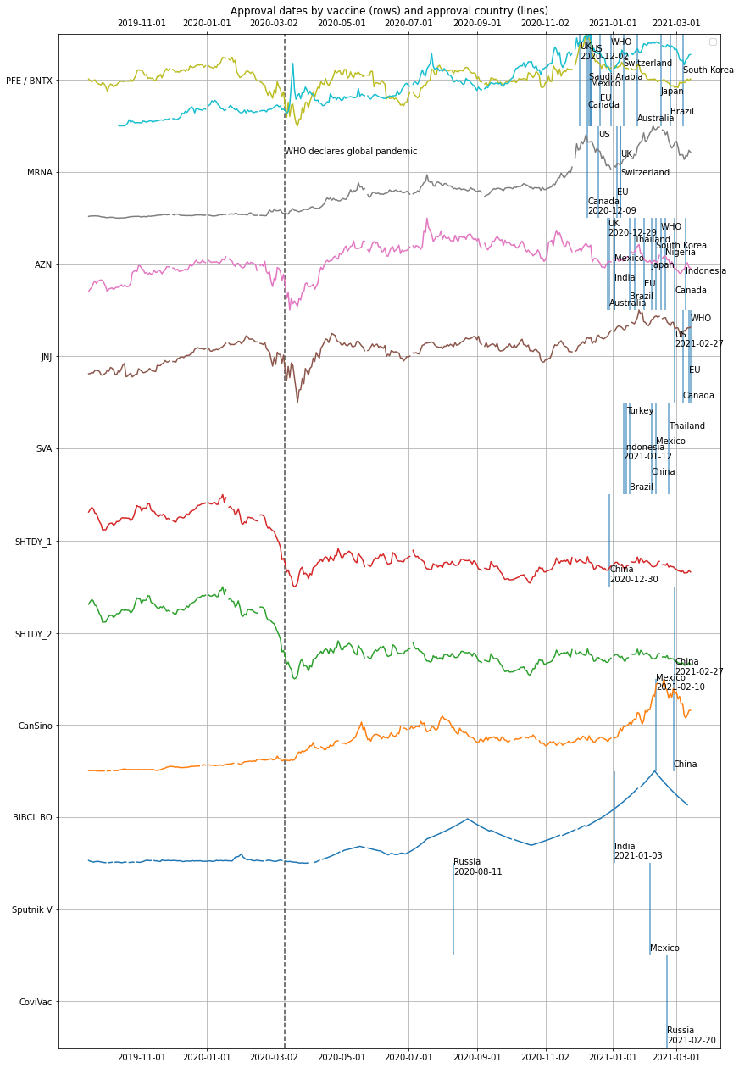
US / EU / UK
Pfizer / BNTX
Moderna
AstraZenica
Johnson & Johnson
China
SinoVac
SinoPharm #1
SinoPharm #2
CanSino
India
Bharet Biotech
Russia
State-funded
Sputnik V
CoviVac

Slide 10
US / EU / UK Pfizer / BNTX Moderna AstraZenica Johnson & Johnson

Slide 11
China SinoVac SinoPharm #1 SinoPharm #2 CanSino

Slide 12
India Bharet Biotech

Slide 13
Observations:
On average, surges in stock price began shortly before first approval of a given vaccine.
Stocks that surged before approval tended to have a transient downturn after approval.
Stocks appeared to only react to approvals of their own vaccine candidates.
Surprisingly non-competitive
US / EU / UK
Pfizer / BNTX
Moderna
AstraZenica
Johnson & Johnson
China
SinoVac
SinoPharm #1
SinoPharm #2
CanSino
India
Bharet Biotech
Russia
State-funded
Sputnik V
CoviVac

